Slide 1
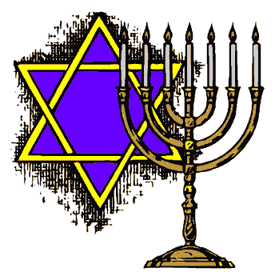
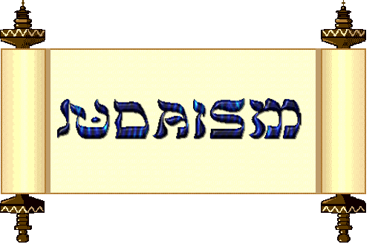
Bennett Psyhogeos
HR 329
Mr. Rabinowitz
March 14, 2011
7 Characteristics of Judaism

Slide 2
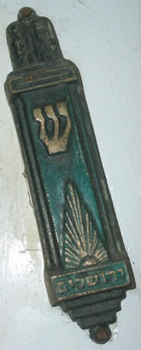
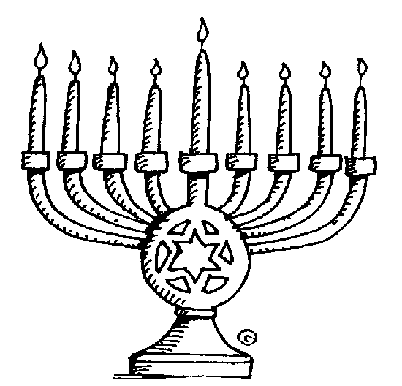
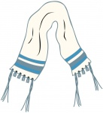
1. Objects and Symbols
The Menorah for Chanukkah
The menorah is the symbol of the Jewish holiday of Chanukkah.
The candelabra has eight-branches with a ninth branch for a so-called "helper" candle, called the Shamash.
Each of the eight candles represent one of the eight nights of Chanukkah.
The Tallit
A four cornered garment worn during morning payers.
The Mezuzzah
A sacred scroll written by hand.
Stored in a protective case.
The Mezuzzah is usually found on the right doorpost of most traditional Jewish homes.
Before the Mezuzzah is hung on the doorpost a blessing is said.

Slide 3
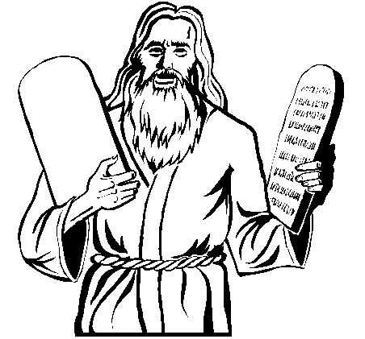
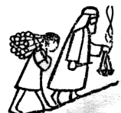
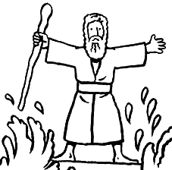
2. Stories of Origin
Abraham
Abraham was a holy man
He believed in 1 God.
God told Abraham to leave the city and his relatives, to go to a holy land.
Moses
A great man who challenged the Pharaoh and army of Egypt in order to deliver the Hebrews (the descendants of Abraham) out of slavery in Egypt and bring them into freedom and back to the Promised Land.
God spoke to Moses and he wrote the Torah.

Slide 4
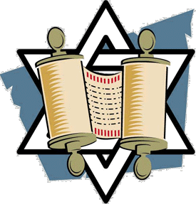
3. Holy Writings
Torah
Torah is the first five books of the Bible
Torah means teaching or law.
Torah was given to Moses in written form with oral commentary.
The word of God and the Jewish Holy book.
Within the Torah are 613 Commandments called Mitzvots.
Written in Hebrew on a scroll made of animal skin.
The Torah is so holy no one is to touch it with their hand.
Tanakh
The Tanakh is the Hebrew Bible, the sacred text. The first five books of the Tanakh are made up of the Torah, the core sacred writings of the ancient Jews.
This also includes Prophets and Writings.

Slide 5
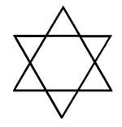
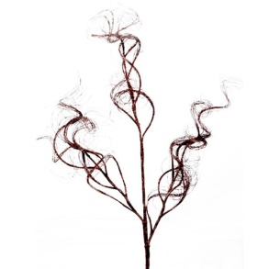
4. Core Beliefs
Core Beliefs
Judaism believes in one God – monotheism.
Jewish people believe that the Messiah has not come yet.
Every human is created in God’s own image.
Torah is the most important text.
Pray 3 times per day.
Give part of their income to charity called Tzedakah.
Rest on the Sabbath.
Three Branches of Judaism
Orthodox- Commandments come directly from God.
Conservative- Many Commandments should be followed and some can be ignored.
Reform- Some Commandments are just not needed and don’t need to be followed.

Slide 6
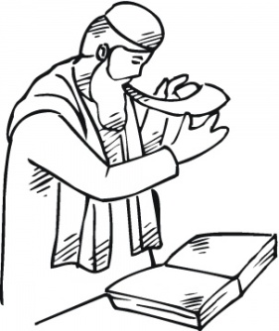
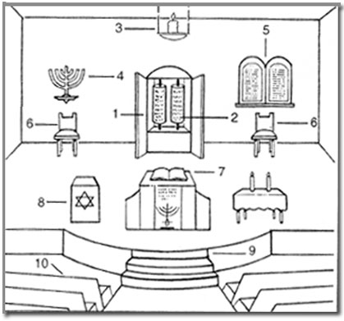
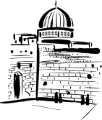
5. Holy Places & Places of Worship
Synagogue
The Jewish house of worship.
Also serves as a community center and education center.
The Rabbi is the religious leader.
The Rabbi speaks about parts of the Torah.
Cantor sings and chants prayers and reads from the Torah.
Jerusalem
Capital of Israel.
The Holy City of Judaism
Western Wall
Located in the Old City of Jerusalem.
The section of the Western supporting wall of the Temple Mount.
The most sacred spot in Judaism.

Slide 7
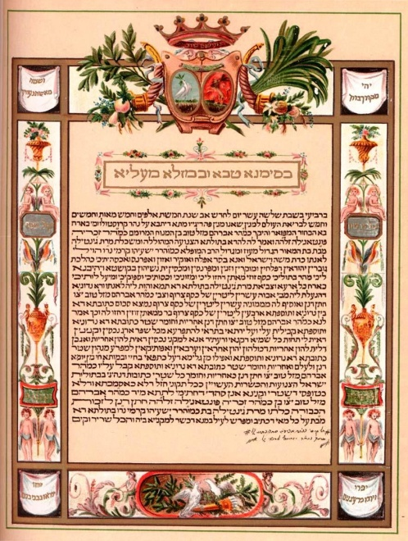
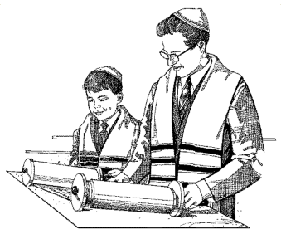
6. Rituals & Rites of Passage
Kiddushin
Marriage
The Ketubah is a marriage contract that is signed by the Bride and Groom in front of two witnesses.
Ketubah says what will be the bride and grooms responsibilities.
Shiva
After a funeral, the Shiva takes place.
Mourners focus on the grief for 7 days.
Bar Mitvah
The child who is coming of age.
A Jewish boy automatically becomes a bar mitzvah when he reaches the age of 13 years and 1 day, and a girl upon reaching the age of 12 years and 1 day.
Allows the right to lead religious services.
The age is marked by a celebration.
B'rit Milah
A baby boy is circumcisized
This happens on the eighth day after birth.

Slide 8
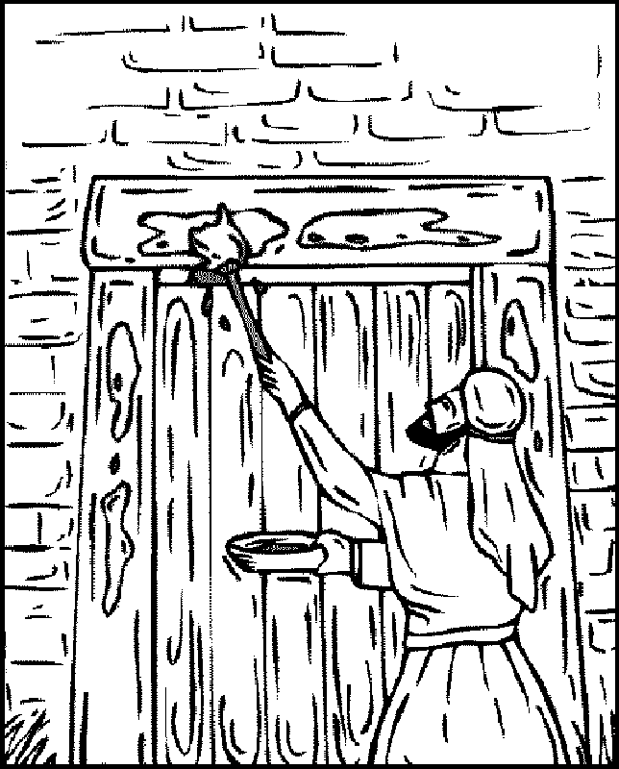
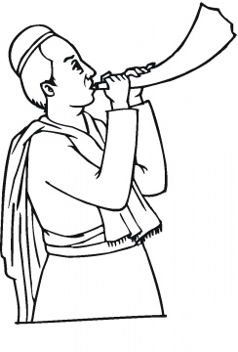
7. Celebrations & Holidays
Passover
Passover celebrates the Exodus from Egypt when the Jews were led out of slavery and into freedom.
God chose Abraham and said that any person born from Abraham would live in a Holy Nation.
Yom Kippur
Day of Atonement.
The Shofar is a rams horn blown at the end of Yom Kippur.
Ask for forgiveness of your sins.
No work can be done on this day.
Chanukkah
A festival of lights.
Eight day celebration.

Slide 9
The End

