Slide 1
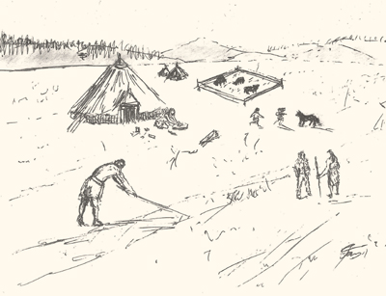
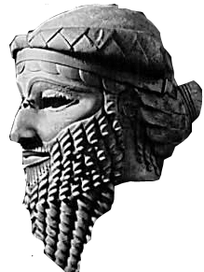
Chapter 2 Section 1 Beginning of Civilization
Webber

Slide 2
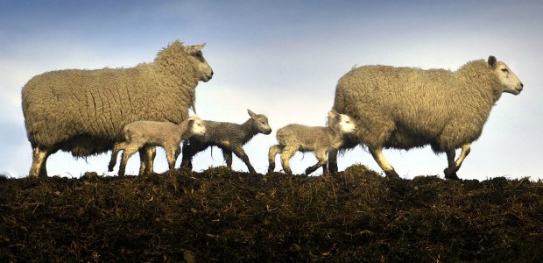
Early Agriculture
Neolithic (new Stone Age) Era began 10,000 years ago
Sometimes called the Neolithic Agricultural Revolution
Hunter-gatherers stopped wandering and settled in one place
Life was still difficult
The Birth of Farming
Temperatures increased and rainfall changed
Glaciers began to shrink- ocean levels rise
Land began to support different plants and animals
Modifying the Environment
People cleared vegetation
Discovered ways to plant seeds for food
Domesticating Plants and Animals
To domesticate means to change the growth of plants or behavior of animals in ways that are useful for humans
Widespread domestication marked the birth of farming
Increased the food supply and made it more reliable

Slide 3
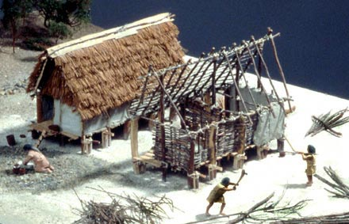
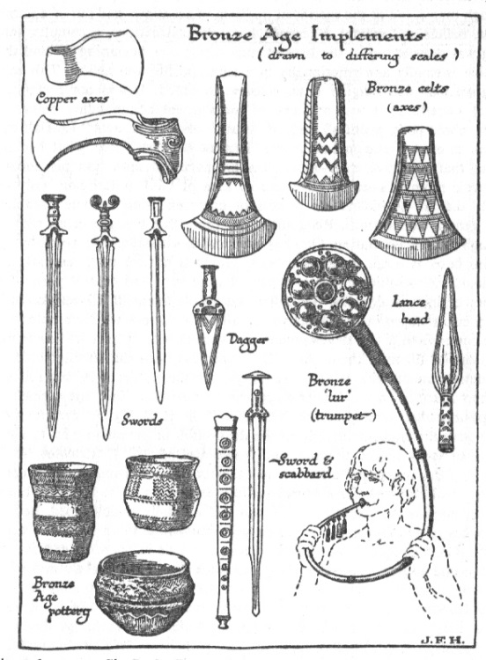
New Tools
Stone Age- refers to tools made of stone or flint
Bronze Age- bronze tools were lighter and had a sharper cutting edge
Iron Age- iron tools were even stronger
The Spread of Farming- The First Centers of Agriculture
Agriculture began in southwestern Asia
Costs and Benefits of Farming
Costs- time and energy needed for planting or herding, uncertainty of success due to weather or disease, and the danger of attack by nomads.
Benefits- food surpluses, smaller land needs, chance to build permanent homes, new materials for clothing

Slide 4
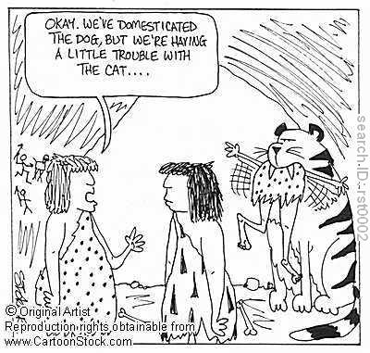
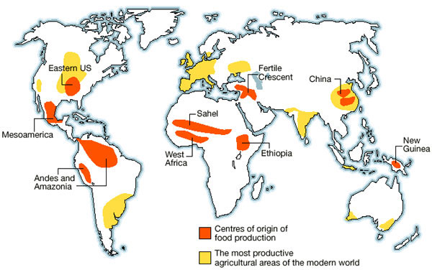
Quick Facts- DO NOT WRITE!
Domestication Challenges: Why were some animals domesticated and others not? If an animal failed to meet any of the six criteria, humans could not successfully domesticate it. First, people had to be able to supply the animal’s typical diet. Second, animals that take a long time to produce offspring or do so over long intervals were hard to breed into a herd. Third, animals with really grumpy temperaments never settled into domestication. Fourth, some animals wont reproduce while under human control. Fifth, animals that don’t organize in herds or don’t establish leaders to follow are hard to domesticate. Finally, some animals cannot tolerate being fenced in or kept in a building and they panic too easily.
Scientists believe that the reason plant domestication began where it did relates mostly to the types of plants that are most easily domesticated and most useful in domestication. This is because domestication had to be both easy and effective in order for farmers to successfully compete with hunter-gatherers for the land. Farming then typically arose in places where certain plants grew wild naturally. It then spread most quickly along east-west lines as growing conditions were most similar in common latitudes. It might surprise students to learn that many of the early agricultural centers like southwestern Asia are not today’s big agricultural producers. This is because over time crops spread to areas where overall conditions better favored human settlement and agriculture.

Slide 5
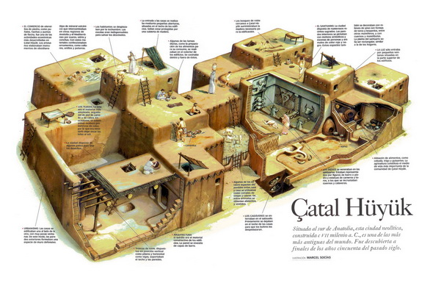
New Ways of Living- New Kinds of Shelter
Farming allowed people to settle, so they needed permanent homes.
They had to be stable so they would last longer.
Used mud and straw
One of the oldest farming settlements is Catalhoyuk in present-day Turkey.
Water and building materials were easily available. The land supported grain and sheep and goat herding.
New Kinds of Clothing
Farming provided new materials that were lighter and easier to work with…
Cotton, linen, wool, and silk from cotton and flax plants, sheep, yaks, and silkworms
Surpluses and Specialization
Some families were able to raise a surplus- or more than they needed to feed themselves.
Population grew- not everyone needed to farm- some people could specialize
Specialization occurs when people spend most of their time working at a single job or craft
Trade occurred
Social Organization
Heads of families began to consult with each other and make decisions for the community\
People began to accumulate possessions- those who had more would eventually have higher social standing than those who had less.

Slide 6
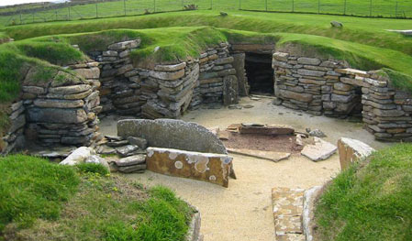
Quick Facts- DO NOT WRITE!
In addition to the production of food surpluses that supported population growth, birth rates also rose. This is because the nomadic lifestyle had limited the number of children a woman could bear. She likely had to carry infants and young toddlers during long treks and could only hold so many. Once a woman had a permanent home, she could bear more children in a shorter time period. As population and specialization grew in farming villages, trade let to a barter economy. Barter is a practice of trading goods or services perceived to be of equal value, and would govern the trade of goods for food discussed in the text. Barter economies continue today in many places, especially during difficult economic times.
Archaeologists studying the remains of Scotland’s Neolithic villages have also learned about life expectancy and causes of death in these early communities. For example, they studied the remains of over 340 Neolithich humans on Orkney, and island off Scotland’s north coast. They found three children for every one adult and only a small fraction of adults over the age of 40. They also found more female than male remains and believe that women often died in childbirth. The skeletons suggested that everyone, including children, worked hard at physical labor. Researchers also found evidence of reasonable diets that included fresh food, and no evidence of violent death.

Slide 7
The Effects of Farming Chart
Hunter-gatherers must travel to obtain food. In small bands of nomads, everyone is involved in getting food.
Farming develops, people domesticate plants and animals and build settled communities.
Tools and crops improve. People can grow more food and build up surpluses.
Population grows larger
With more people and enough food, not everyone must be involved in farming.
Specialization develops. People become potters, weavers, toolmakers, healers, storytellers, and so on.

