Slide 1
Feudalism
From the Norman Invasion to the Black Plague, how feudalism started and ended, how it worked, and its benefits and drawbacks

Slide 2
Feudalism’s Beginnings
Feudalism was a system of government that originated in France in the 900’s.
It came out of a need for protection due to the Viking attacks and raids on villages furthest away from the central power
French nobles decided to protect their land and people by divvying up their land and appointing others to police each portion

Slide 3
Feudalism comes to England
Feudalism came to England by way of a man named Duke William of Normandy.
Duke William was a distant relative of the king of England, and so he decided that he had a right to be King of England.
In 1066, he waged a war with England and famously defeated the King (King Harold, also known as Harold the Fat) at a battle called The Battle of Hastings. He was then crowned king of England.

Slide 4
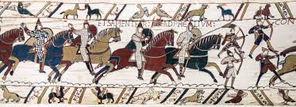
A woven mural of The Battle of Hastings—1066

Slide 5
Feudalism comes to England cont.
So England had a new FRENCH king.
William (now called William the Conqueror for defeating the English) decided to secure his power by kicking out all the powerful English nobles.
He then replaced them with French nobles
This is why French became the language of the elite classes in England (only wealthy people spoke both)

Slide 6
How Feudalism Works
Feudalism works based on an exchange system of loyalty oaths, service, and taxes, and gifts of land (called fiefs) and protection.
The ruling class (including the King and nobility) would offer fiefs and protection to those underneath them—these people are called vassals
In exchange, the vassals pay taxes, promise loyalty, and provide service and labor

Slide 7
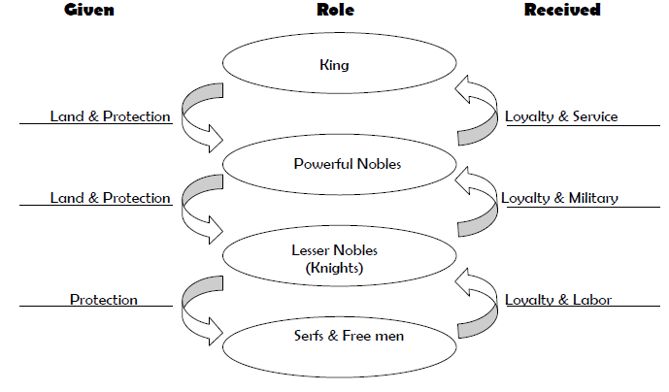

Slide 8
Was it effective?
The system worked for some, but not for many
Most of the population was incredibly poor, and did not own their own property. For these people, feudalism made life difficult.
Perhaps it is for this reason that it didn’t last long as a system of government

Slide 9
The end of Feudalism
When the Black Death (the plague, also known as the pestilence and The Great Mortality) came to England in the mid-1300’s, it wiped out one-third of the population. Most of the people that died were peasants who worked the land for the upper classes.
Once they were gone, there were few people to work the land, and so the nobles found they couldn’t force peasants to work under the previous conditions.
Once nobles no longer had control of their peasants, the system collapsed.
The period that followed Feudalism and the Middle Ages is known as the Renaissance, meaning “the rebirth”

