Slide 1
Kingdoms of West Africa

Slide 2
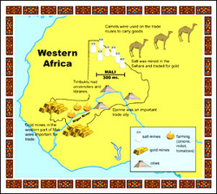
Gold/Salt Trade
http://youtu.be/RUZxZiNIWqc

Slide 3
Trade in the Sahara
Salt was rare in many regions of Africa. It was important to human health. This combination made it highly prized as a trade item.
The earliest development of trade in the region, however, was tied to another important development-agriculture

Slide 4
Surplus Leads to Trade
Farming villages began to produce a surplus, traded their surplus food for products from other villages
Gradually a trade network linked the the savanna to forest lands in south and then moved goods across the Sahara to civilizations along the Mediterranean and Southwest Asia

Slide 5
From the West, crossing the Sahara-leather goods, kola nuts, cotton cloth and enslaved people.
From North Africa, Arab and Berber merchants brought silk, metal, beads, and horses.

Slide 6
B. Trading Gold for Salt
Gold and Salt dominated the Sahara trade.
Gold was widely available in West AFrica
Found in the soil along the rivers

Slide 7
West Africans traded gold for salt.
People need salt in their diet to replace salt lost in perspiration
needed to preserve food
sahara had an abundance of salt
1 lb of salt=1 lb of gold

Slide 8
A farming and trade prospered, cities developed on the northern edges of the savannah.
Soon strong monarch arose, gained control of profitable trade routes and built powerful kingdoms.

Slide 9
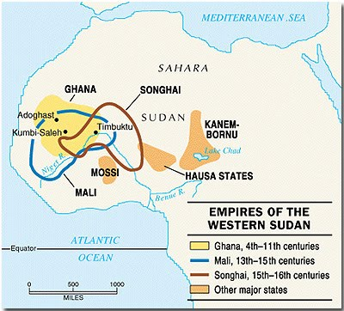

Slide 10
II. Ghana:The Land of Gold
By AD 800, rulers were able to unite many farming villages and created the kingdom of Ghana.
located in a fertile ‘V’ shaped region between the Niger and Senegal Rivers
King controlled trade across West Africa
King taxed all goods entering and leaving his land.
Ghana-land of gold

Slide 11
Influence of Islam
Muslim merchants brought their Islamic faith with them to Ghana
Muslims employed by the king
learned military technology and government
Islam spread slowly at first, most kept their traditional beliefs
Almoravids conquered Ghana-not for long
Ghana swallowed up by Mali

Slide 12
III. Kingdom of Mali
During Ghana’s collapse, Mandika people on upper Niger River suffered a defeat by rivals. Their king and all but 1 of his sons was executed, he was thought to be too weak-no threat
By 1235, Sundiata crushed his enemies, won control of the gold routes and founded Mali

Slide 13
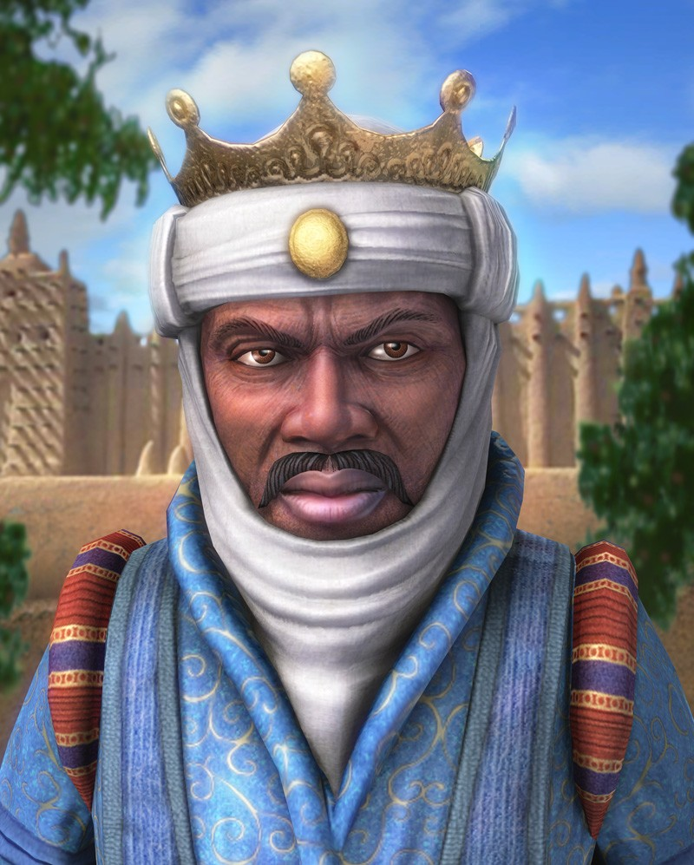
Mansa Musa Rules Mali
Mali=Arabic for “where the king dwells”
Mansas=kings
Controlled both the gold and salt deposits
Towns like, Timbuktu, along the routes flourished
Greatest Mali ruler, Mansa Musa expanded the empire to the Atlantic Ocean
reigned for 25 years, kept peace, converted to Islam, based on Quran
To keep peace, did not force Islam, religious freedom and tolerance

Slide 14
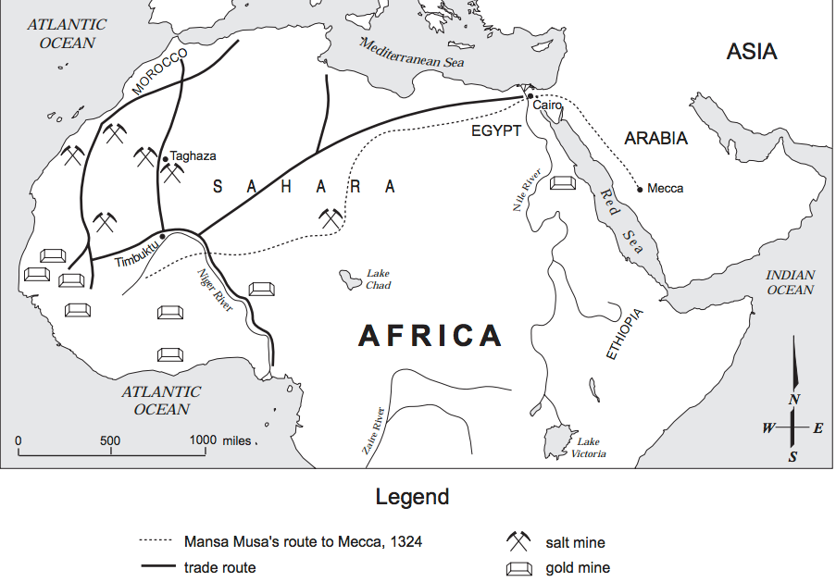
B. The Hajj of Mansa Musa
1324, Mansa musa travelled to Mecca-hajj
Made political and economic ties with other Muslim states
Brought back scholars, architects and teachers to promote Islamic education in Mali
Islamic university built in Timbuktu

Slide 15
IV. A New Empire in Songhai
In the 1400s, disputes over succession weakened Mali. People broke away and the empire shriveled.
1460s wealthy trading city, Gao, becomes capital of new West AFrican Empire, Songhai-ruled by Askia Muhammed

Slide 16
Extending the Empire
Becomes the largest empire in West Africa
Did not adopt Islam, followed traditional beliefs
New leader sets up Muslim dynasty-organized government into departments, farming, military , treasury
Also made trip to Mecca and established strong ties
built mosques and schools to study the Quran

Slide 17
B. Armies Invade from the North
Disputes over succession leads to civil war
Attacked by armies from Morocco, using gunpowder, conquered Songhai

Slide 18
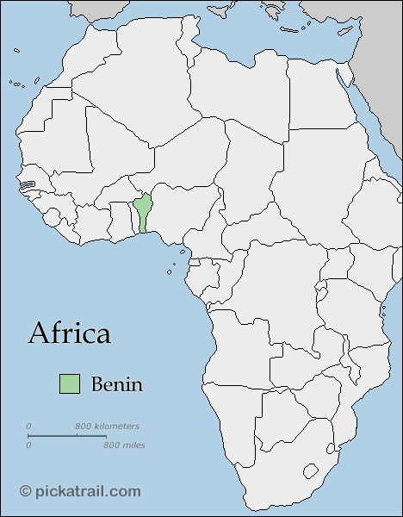
V. Smaller Societies of West Africa
Benin-rain forest, traded pepper, ivory, and slaves
Hausa-fertile northern plains, cotton weavers, leather workers. Women leaders, walled cities

Slide 19
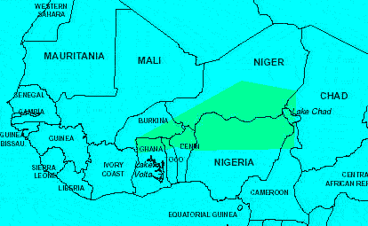
Hausa

