Slide 1
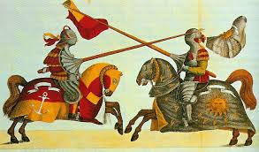
Knights and their Chivalric Code

Slide 2
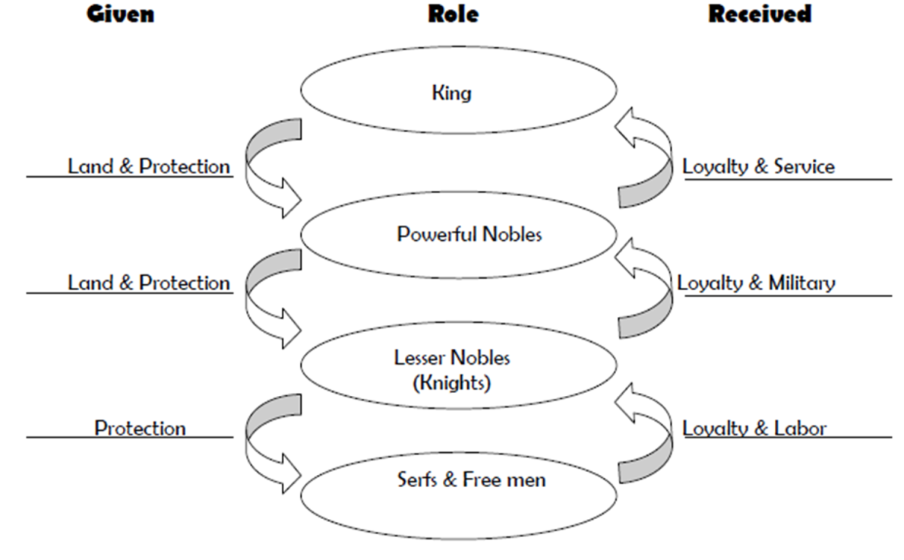
Knighthood
Knights were an important class of people within the feudal society. In terms of hierarchy, they ranked below the lesser nobles, but above the merchant and peasant classes.
Knights were
appointed by the
lords they served, and
were given fiefs of
land in exchange for
loyalty and service.

Slide 3
Becoming a Knight
Children would begin training to become a knight as early as age seven!
There were a few steps to take before becoming a knight:
  Page: for the youths in training; these children were taught in Latin and mostly learned how to ride horses, hunt, and care for animals
  Squire: at age 14 they would begin training with armor and weapons; would often assist other knights as a part of their training and education
  Knight: a special ceremony gives them the title; they would wear white robes and fast for two days to prepare for it!

Slide 4
Life of a Knight
A knight’s duties were to his lord. Primarily, these included:
  Providing military service should there be a battle or war
  Providing protection to the lord and the people on his lands
  Policing the lord’s lands and people (upholding laws)
When knights were not “working,” they often played war by competing in tournaments. This was a way for knights to keep their skills sharp, to earn money, and also to earn fame for their lord.

Slide 5
Playing War & Tournaments
We often think of knights as jousting and competing—this was often how they spent their time when not engaged in real battle!
Jousting was very expensive, very dangerous, and very difficult. The best knights could walk away with lots of money…or they might never walk again.
          In addition to jousting, tournaments often held other events, such as mock battles, sword fights, archery contests, and horse-training events.

Slide 6
Knights and their Weapons
Armor: weighing up to 100 pounds, knights would wear heavy iron plates, chain link vests, pads, and helmets with visors to protect themselves
Sword: the primary weapon of a knight; swords were heavy, with large handles that could also be used as part of the weapon; they were very expensive!
Shield: not just for defense, but a shield could be used to slam an opponent or slice at them
Staff: usually made from a sturdy tree branch, staffs were long, agile weapons that could hit and sweep at a man, as well as block advances
Bow and Arrow/Crossbow: more of a distance weapon, bows and arrows were the sniper’s rifle of the time; crossbows were the automatic guns
Mace/Flail: a heavy club with a metal, spiked ball or cylinder at the end; flails had chains so that the ball could whip around in the air
Lance: for jousting or horse-mounted attack; a long spear with a heavy handle that had to be cradled under the arm to hold it in place

Slide 7
Knights and their Weapons cont.
Let’s watch this video about weapons of the Middle Ages:
http://www.history.com/topics/middle-ages/videos/weapons-of-the-middle-ages

Slide 8
Origins of Chivalry
A product of feudalism, chivalry was an idealized system of manners and morals.
Many of the ideals came from the Catholic Church, which was the central power in the Middle Ages.
The most important concept within chivalry is loyalty. For the most part, this meant loyalty to a feudal lord, but later on in history, it included romantic loyalty, known as courtly love.
There are many literary sources for chivalry, including:
  The Knight’s Tale
  Beowulf (an epic from the early Middle Ages)
  Sir Gawain and the Green Knight
    "'Lord!' said Gawain. 'How lucky I am,
    Lady, not to be the knight you speak of:
    To take that kind of honor on my own
    Would be sinful; I know myself too well.
    By God, I'd be glad, if it pleased you, to offer you
    Some different service, in word or deed
    To serve such excellence would be endless delight." Part 3, lines 1241-1247

Slide 9
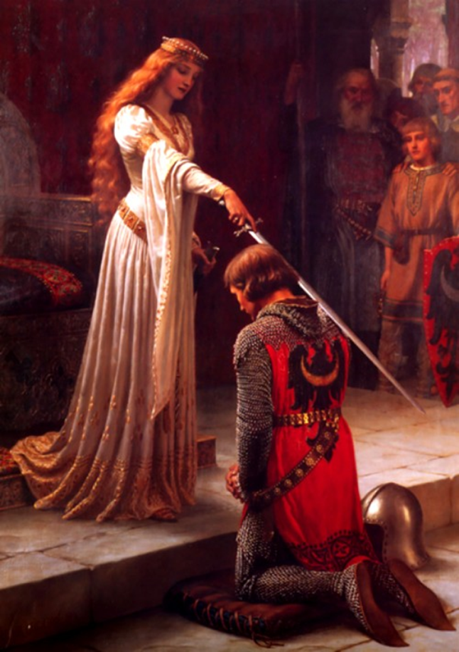
Chivalric Code of Honor
The Medieval knight was bound to the chivalric code to be loyal to:
  God
  His lord/countrymen
  His lady
Chivalric ideals include:
  Fairness (even in battle!)
  Mercy
  Benevolence
  Brotherly love
  Courtly love
  Politeness
  Honor
  Bravery
  Piety
  Protecting the weak

Slide 10
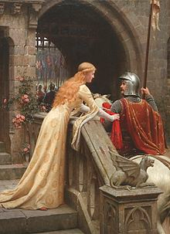
Acts of Chivalry and Quests
Acts of chivalry as noted in historical literature include:
  Doing battles or other quests for a feudal lord
  Saving/rescuing anyone in need of help, especially those who are weak and cannot help themselves
          Courtly love: loving and doing whatever noble ladies ask. Courtly love is especially selfless because a knight could never actually marry a woman ranked higher than he
          Helping other knights in battles/quests, even if they are the enemy—always fight fair!
          Saving fair damsels

Slide 11
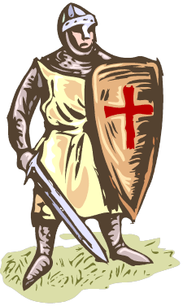
Acts of Chivalry and Quests cont.
A quest is a hero’s journey towards a goal. The objects of quests require great exertion on the part of the hero, and the overcoming of many obstacles.
  Some quest stories include a test of the hero’s character and virtues.
The heroes must obtain something, or someone, by the quest and with this object return home. To fail is to be shamed, and the consequences could include the
loss of one’s knighthood as well as one’s pride.

Slide 12
Is Chivalry Dead?
Many knights of the era did not adhere well to the chivalric code (e.g. the crusades).
Does this make them unfit as knights?
What are some of the potential problems with knights following the chivalric ideals?
People today sometimes say that chivalry is dead—is it?
  What examples of chivalry do we see in modern society?
  Do the ideals of chivalry still work in our culture today? Why or why not?
  Are they still relevant? Why or why not?

