Slide 1
The Norman Invasion
How French language, life, and culture became part of English history

Slide 2
Why learn about the Norman Invasion?
In all four of the Medieval Historical Fiction novels studied during this unit, there is at least one mention of French language, life, and culture.
The Norman Invasion changed the path of English history, and (as a result) greatly impacted the histories and cultures of other countries, like the United States!

Slide 3
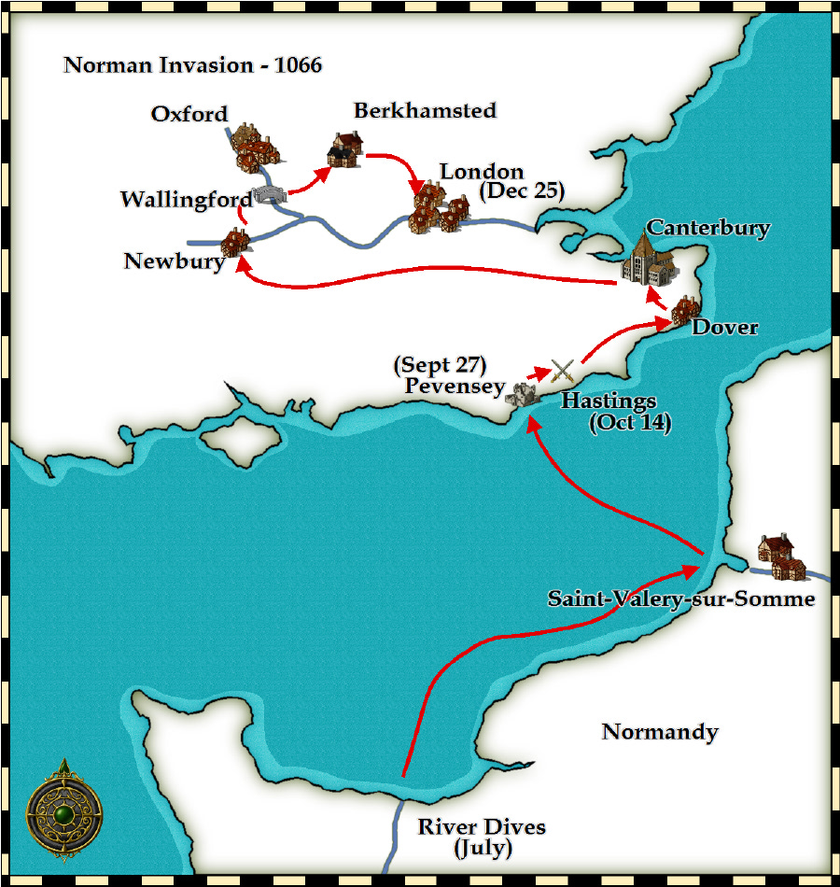
Norman refers to the north west coast of France, called Normandy.
When the Duke of Normandy, William, traveled across the English Channel to England, he began what is called the Norman Invasion. Ultimately, he was successful in taking over England and becoming the first French King of England.

Slide 4
When & Where did this happen?
The Norman Invasion happened in 1066 and lasted until 1072, when Duke William of Normandy secured his throne as King of England
The most famous battle is known as the Battle of Hastings, and took place on October 14th, 1066.

Slide 5
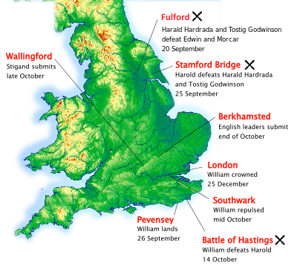

Slide 6
Who was involved?
After King Edward died in 1066 leaving no heir, three men fought for the title of king:
Duke William of Normandy
Harold Godwinson (also known as Harold the Fat, for he was the richest and fattest noble in all of England)
Harald Hardrada of Norway
These three men all claimed to be next in line for the English throne, and so they all fought.

Slide 7
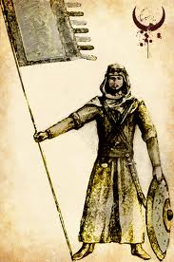
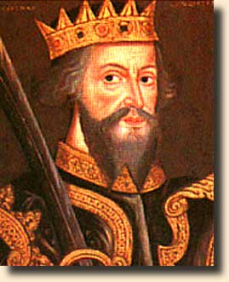
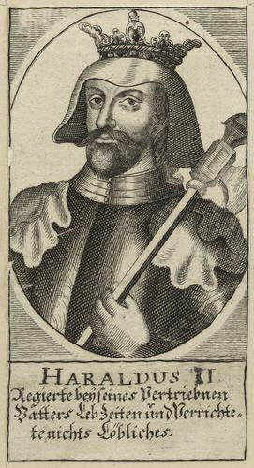
Harald Hardrada
Duke William
of Normandy
Harold Godwinson

Slide 8
Who beat who?
When Harald Hardrada and his armies came down from Norway, the English Earl Harold Godwinson met him at Stamford Bridge in northern England and defeated him. (September, 1066)
After that, Godwinson had to defeat the Norman Duke, so he marched south to Hastings, south of London.
There, William of Normandy, also known as William the Conqueror, beat Godwinson.
According to a famous tapestry depicting the Battle of Hastings, Harold Godwinson died in the battle from receiving an arrow through his eye.
Ultimately, Duke William of Normandy was crowned King of England on Christmas Day in the year 1066.

Slide 9
What was the result?
Duke William became the first ever French King of England.
He brought over his own nobles and replaced the English nobles to assure his power.
This was not very well-liked, and so there were still many fights until 1072 when the last of the English resistance was put down
William wanted to know the state of his new kingdom, and so he commissioned The Doomsday Book—the first ever national census, recording exactly how many people, animals, and natural resources England had.

Slide 10
Focus on: Language
With all these new French nobles and knights coming to England, the language of the rich and powerful became French.
A great example of this is the English vs. the French words for animal foods—
The poor English peasants worked in the fields and used the English words for animals: pigs, lambs, and cow
The rich French nobles who ate the food used the French words for the meat: pork, mutton, and beef (translated they are pork, mutton, and beouff)
French even began to meld with English, and so Norman English was born—a sort of combination between French and English
People even started naming their children with French names, like William, Robert, and Richard
Many French words still exist in our English today!
Hors d’oeuvres
Entrepreneur
A la carte
Armoire
Cliché
Montage
Sabotage
Silhouette
Impasse
Faux-pas
Dénouement
Concierge
Banquet

Slide 11
Focus on: Politics
With the new King of England being French, the relationship between France and England changed forever.
Most future Kings of England were crowned as King of England, Ireland, and France until 1453 when the dual-monarchy system failed, though England and France still remained politically close.
After 1066, Englishmen unhappy with the new King emigrated to other countries, including Ireland, Norway, Scandinavia, France, and even to the east as far as Byzantium.

Slide 12
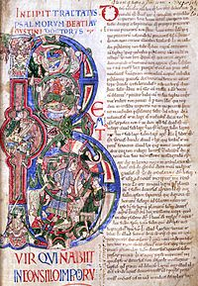
Effects still seen today
In addition to the persistence of French language, there are also still examples of the French Invasion in other areas too!
Buildings began to have rounded arches and turrets instead of square or vaulted
Manuscripts were illuminated and became even more common
Many Englishmen speak French, and many Frenchmen speak English because of geographical proximity, but also this history!

Slide 13
How it relates to our Medieval Historical Fiction Unit
Catherine, Called Birdy: Perkin speaks French! Why does this not fit with what we’ve learned about French language and social classes?
Adam of the Road: Adam knows songs in French and sings them to the fancy ladies along the road. Why are only the romantic songs sung in French?
The Door in the Wall: Some characters speak both French and English—who and what class are they in?
Girl in a Cage: History is written by the winners—Robert the Bruce is also called Robert de Brus…why change the spelling?

