Slide 1
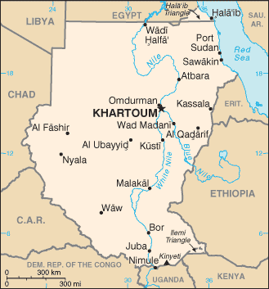
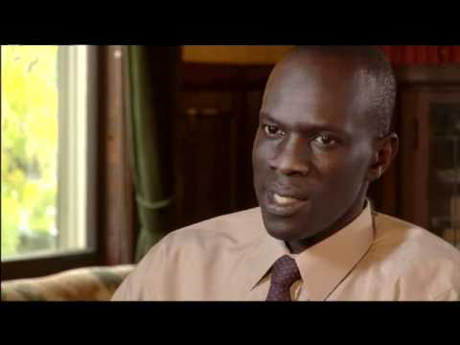
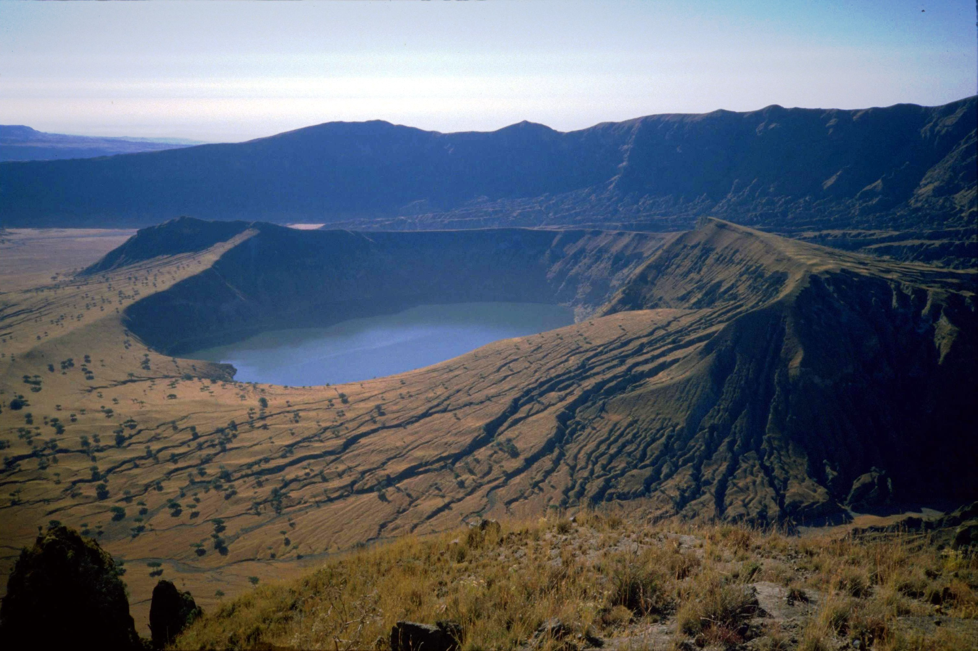
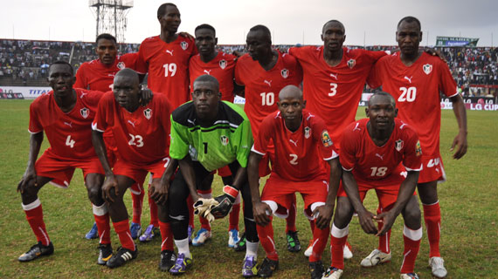
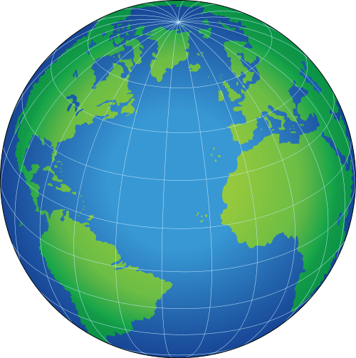
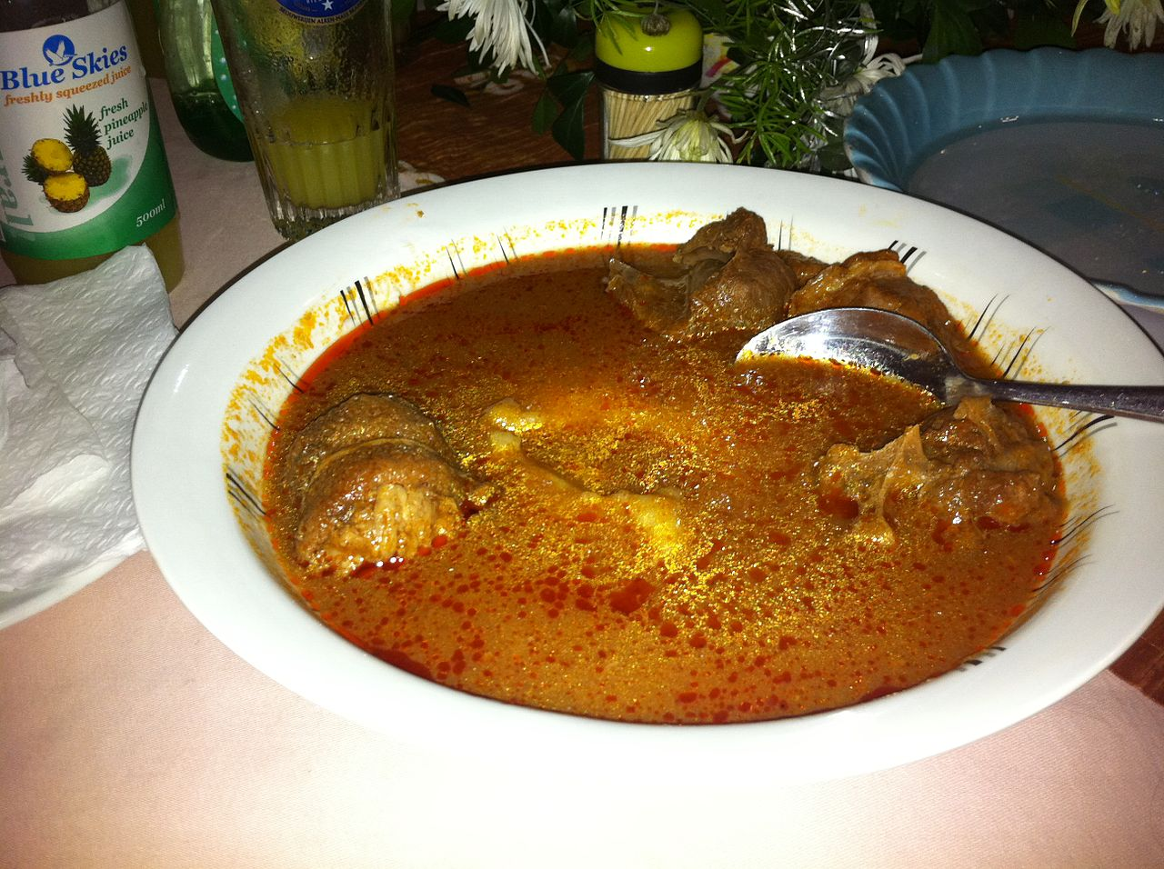
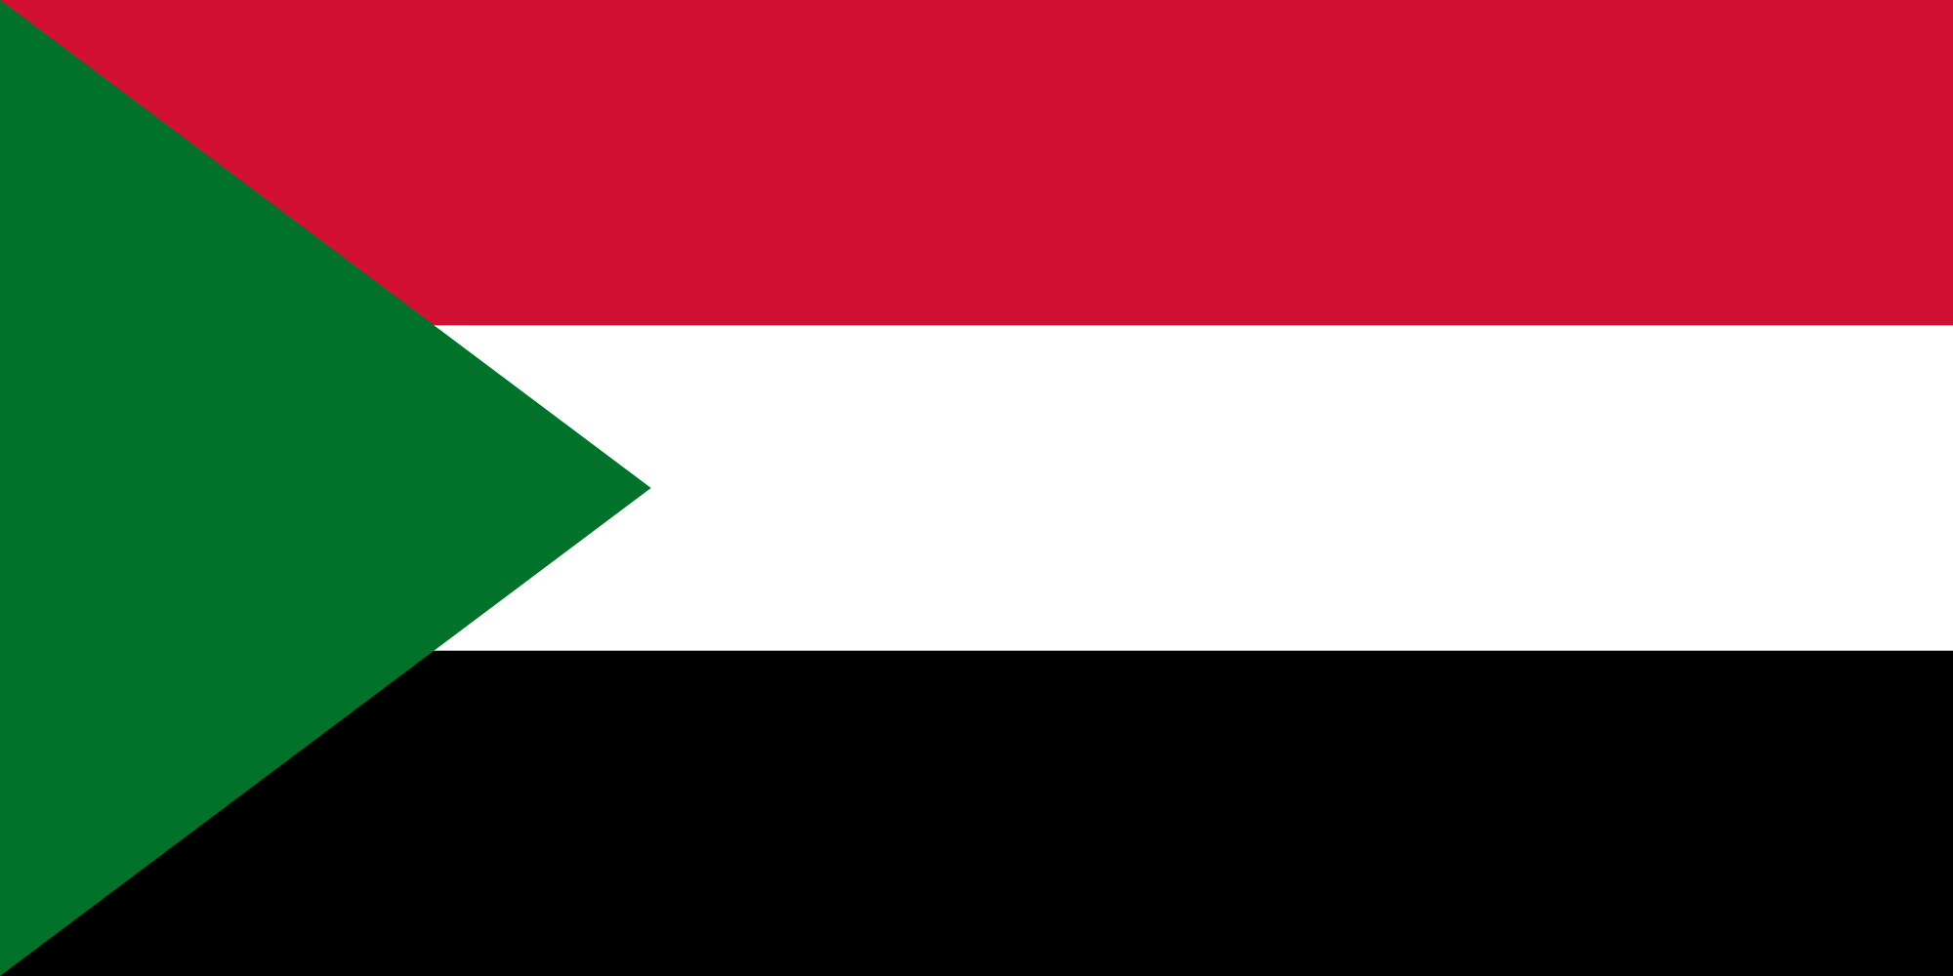
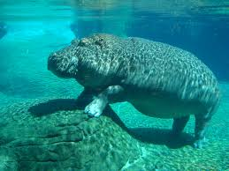
Sudan

Slide 2
Salva Dut was one of the lost boys of Sudan he experienced so many things that had a tremendous impact on his life. But now Salva is the Executive Director and CEO of water for South Sudan. WFSS will go to villages who don't have access to clean water and drill down to construct a well. WFSS is bringing new life in villages across South Sudan.He is very important and changed people's life.

Slide 3
Stew or better known as soup is one of the most popular foods in Sudan. For them it's pretty easy to make.This one in the picture is pine nut stew with goat meat in it.

Slide 4
The Sudan national soccer team or (football team) represents Sudan in and is managed by the Sudan football association. The governing body for football in Sudan. They play at Al Merreikh stadium in Omurdurman Sudan, their head coachs name is Mohammed Abdullah Mazda. Sudan was one of only three teams to play in the African Cup of nations in 1957. And the other were Egypt and ethiopia. Sudan belive it or not also one of the oldest teams in Africa. In the past they also reached up to 74 in the fifa rankings.

Slide 5
Just some
Facts :)
-Sudan mainly speaks Arabic
-Their currency is a Sudanese pound
-Sudan was the only east african team to qualify for the African cup of nations in 2012.
-Sudan's current fifa ranking is 129 and climbing

Slide 6
The Marrah Mountains are a rugged volcanic chain extending for 100 miles in the west-southeast of Al-Fashir in western Sudan. The highest point of the nile-lake chad watershed reaches above 10,000 feet

Slide 7
Hippos can be seen all over in Sudan in rivers and on the edge of lakes. But mainly across the eastern part because of the nile river.
Its not fat its just blubber

Slide 8
Geography
-Population= 40,235,000 million people
-Landforms= Mountains, grassland, savannah, and desert
Important products= cotton,sorghum,millet,petroleum, iron ore, copper

Slide 9
Sudan is one of the largest countries in Africa with a size of 728,215 sq miles, large huh. The capital is Khartoum and holds the majority of the population. Its also a very important country because the nile flows through it.

Slide 10
The sudanese flag has colors that each mean something.
Red, white, black and green are called the pan-Arab colors and have been historically linked to the Arab people and Islamic religion for centuries. The colors stand for Arab unity and independence. The red stripe represents Sudan's struggle for independence and many other struggles, and the sacrifices of the country's martyrs. The white represents peace, light and optimism. It also represents the White Flag League which was a nationalist group that rose up against colonial rule in 1924. The black represents Sudan in Arabian.

