Slide 1
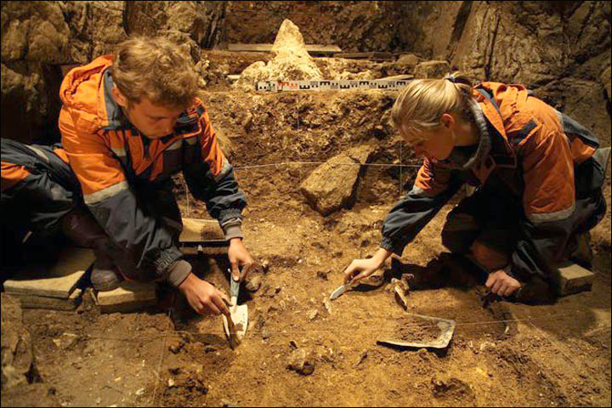
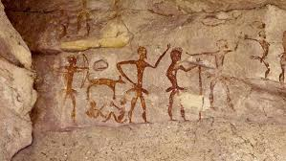
Studying the Distant Past-Early Man

Slide 2
Study of Early Humans
Anthropology-study of how human beings behave, act together, where they came from, and what makes one group different from others.
Archaeologists-study human life in the past by examining the things that people left behind

Slide 3
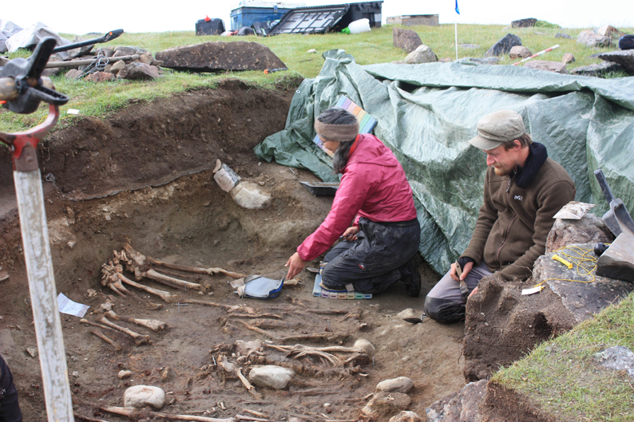
Until about 5,000 yrs. ago, people had no way to write things down.
Pre-history-time before things were written down
Archeologists, look for the places where people may have lived.
Why?

Slide 4
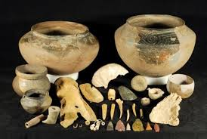
Things left behind may include:
Fossils-bones, plants, feathers
Carbon Dating- the more carbon found=younger remains, less carbon=older remains
Artifacts-objects made and used by humans

Slide 5
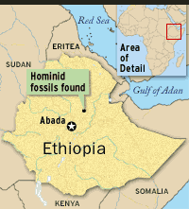
The Hunt for Early Humans
Where did the first human remains
appear on earth?
Leakey's-gorge in Eastern Africa
Donald Johnson-”Lucy”-Ethiopia
Tim White-”Ardi”
Michael Brunet-found remains in Central Africa

Slide 6
Hunter-Gatherer Societies
These humans lived by hunting small animals and gathering plants.
Harsh life, many groups died out
Need to develop tools and skills to meet their needs, made life easier-technology

Slide 7
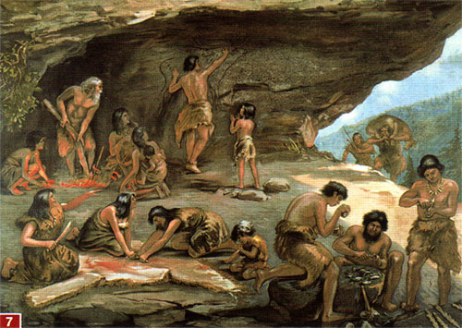
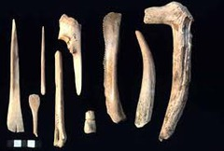
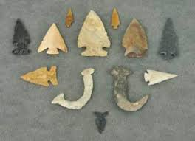

Slide 8
Development of Tools
Made of stone-Paleolithic-Old Stone Age
These tools needed to cut, chop, scrape animal skins.
Eventually became weapons, enabled humans to hunt for larger animals.
Fire- why was this an important step in human development? What good is fire?

Slide 9
Wandering Bands
Culture-the way of life of a people
Stone-Age hunters lived in small groups
Nomads-people who move from place to place with the seasons, WHY?

Slide 10
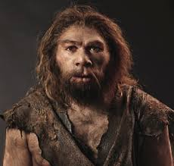
Later Stone Age People
Neanderthals-found in Neander Valley, Germany
First to bury their dead?
Homo Sapiens-”wise people”
Taller, less muscular
Developed complex language

Slide 11
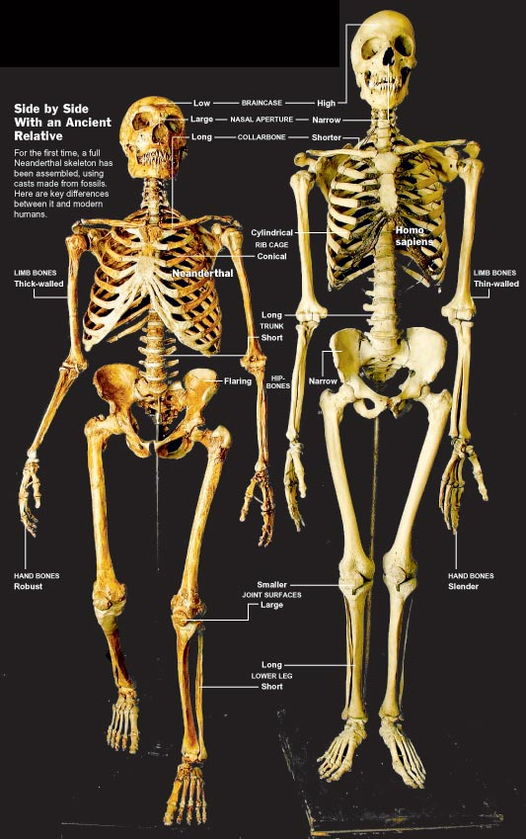
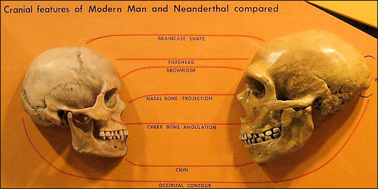

Slide 12
How does having a shared language help a culture?
Neanderthals eventually disappeared
lost a battle
mixed in with other groups

Slide 13
Populating the Earth
Many groups of early humans appeared and then died out. Homo Sapiens or modern humans were the last to appear.
Over many thousands of years, they spread out to populate almost every land area of the world.

Slide 14
Migration Theories
Originated in Africa, migrated to
other parts of the world
Some scientists believe these large-brained humans developed in different parts of the world and then mixed to become 1 group, known as Homo Sapiens.

Slide 15
Adapting
As humans migrated, they settled into new environments and had to adapt to different climate, plants, and animals.
They had to change their way of life to survive
Forming larger communities-hunt together, defend their communities...became clans (25-50 people)

Slide 16
Developing Culture
Clans mingled for trading of objects and information
Paleolithic communities become more complex,
artwork is one example: Las Caux
religion
farming

Slide 17
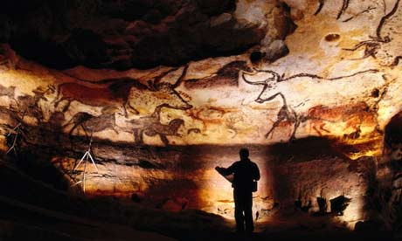
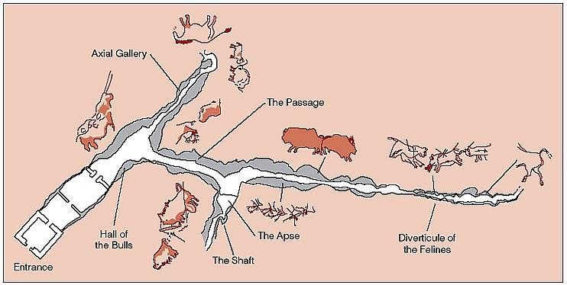

Slide 18
