Slide 1
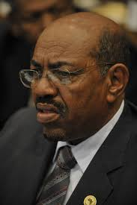
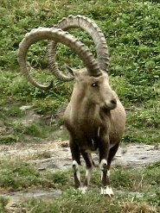
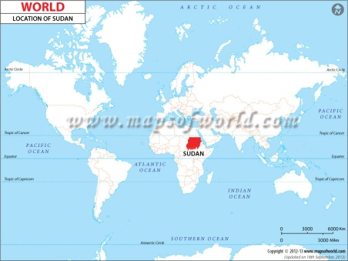
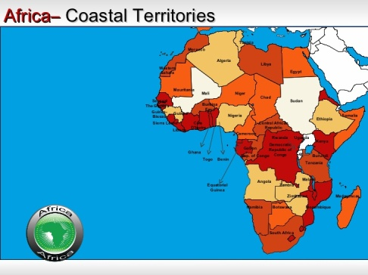
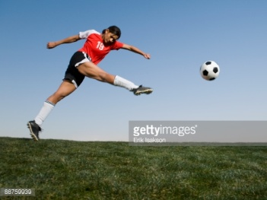
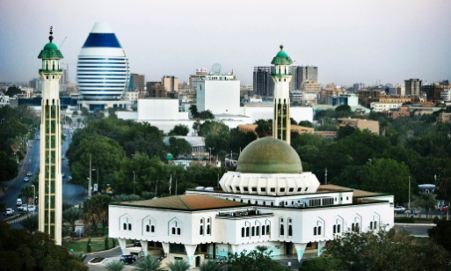
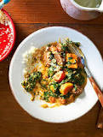
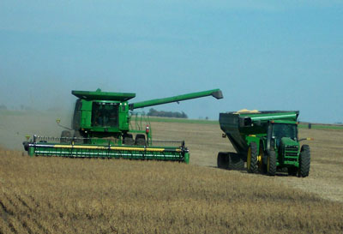
Sudan Digital Quilt By Nathan Riggs

Slide 2
This is Omar al- Bashir He was born January 1st 1944, he came to power in a coup in 1989, and has ruled Sudan ever since. When he seized power, Sudan was in the middle of a 21-year civil war between north and south. He agreed to let the south go and they became there own nation. He is accused of genocide , murder and lots of other bad things. He is currently 72 years old and still the current leader of Sudan.

Slide 3
This is the Sudanese flag, and each color represents something important in their history and culture, Red signifies the struggle for freedom, White is the color of peace, light, and love, Black represents Sudan itself, Green is the color of Islam, agriculture, and prosperity.

Slide 4
This is the Nubian Ibex also known as the Carpa Ibex Nubian, lives in the Sudanese desert. Both the males and the females have the curved horns, but the females are considerably shorter. Their coat is light sandy brown color. Its underbelly is white and its legs are marked with black and white dots

Slide 5
Football, soccer as we know it, is one of the main sports played in Sudan. It is not specific to just one area, all of Sudan loves to play. Sudan is actually one of the founders of football along with Ethiopia, Egypt and South Africa. In 1956, Sudan hosted the African Cup of Nations and then they won the cup in1970.

Slide 6
Sudan is located in the North East side of Africa.

Slide 7
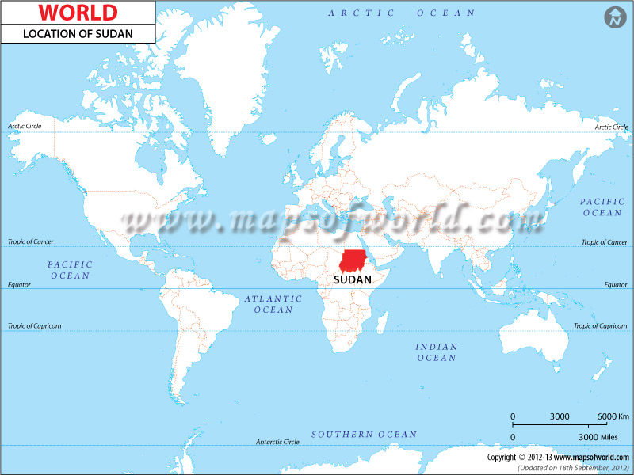
This is where Sudan is located on a world map.

Slide 8
This is the Capital of Sudan, Khartoum. Over 1 million people live in Khartoum. Khartoum was founded by the Egyptians in 1821 and became the capital of Sudan when Sudan got its independence from the Britain in 1956.

Slide 9
Porridge is the main meal in Sudan. It is with wheat, sorghum or corn flour, the starch is served alongside stews. Broad bean balls are also popular meals. Porridge is not just for breakfast, it is served for all meals.

Slide 10
This is a picture of Sudan harvesting one of many crops. Some of these crops include wheat, sesame, cotton, and tomatoes. The water supply for these crops comes from the Nile its self.

Slide 11
Citations
Copyright © 2016 BBC.
© 2015 IndexMundi. All rights reserved.
©2011 TheWebsiteOfEverything.com
All contents © copyright 1999-2016 Getty Images
LinkedIn Corporation © 2016
© Compare Infobase Ltd.
© 2016 Guardian News and Media Limited or its affiliated companies. All rights reserved.
© 2016 About.com — All rights reserved.
All information, artwork, graphics, text, copy, data, software, advertisements and other material included in the Network ("Material") is SBS's or its licensor's copyright material
Copyright © 2016 Embassy of the Republic of the Sudan. All Rights Reserved.

